Slide 1

QNQ FRANCHISE
“Buy companies with strong histories and profitability and with a dominant business franchise’’

Slide 2


QNQ Franchise Information
A franchise involves individuals, known as franchisees, purchasing rights to operate a business using the branding, products, and services of an established company, the franchisor.
This enables the franchisee to leverage the established reputation and success of the franchisor's business.

Slide 3





Could you please click on the video?
Could you please click on the video?
HOW TO INSTALL THE QNQ FRANCHISE APP
Open the Play Store.
Search for the 'QNQ Franchise' app.
Downloaded the app.

Slide 4
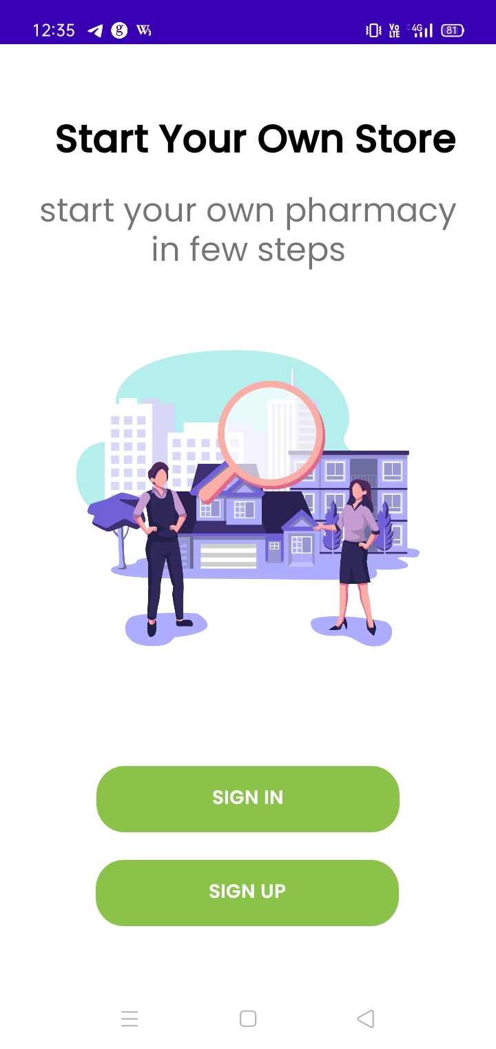
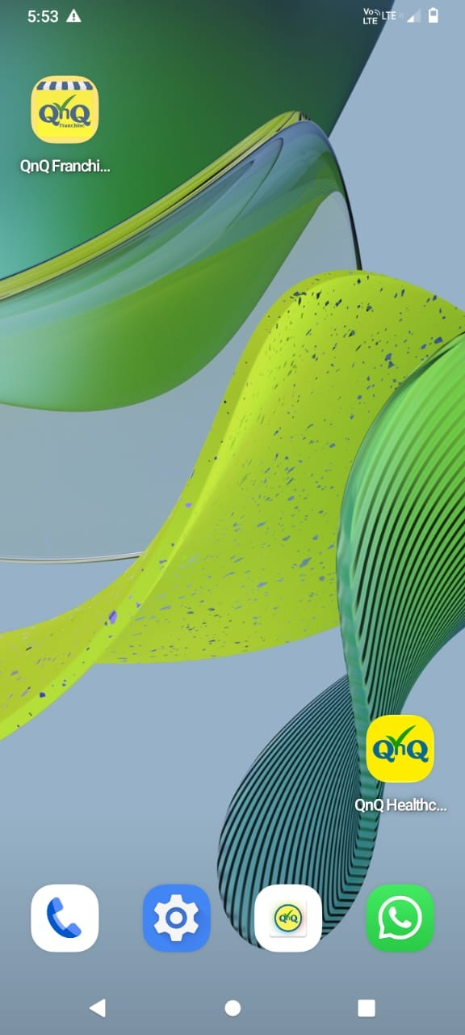
After downloading the app, it defaults to displaying on our devices.
The 'QnQ Franchise' app was open, and the login page was displayed.
First, sign up for the QNQ Franchise app.

Slide 5
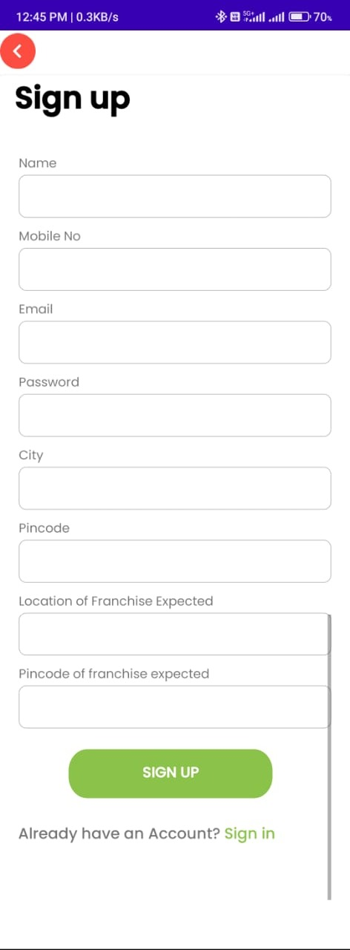
Could you please click on the video?
HOW TO SIGN UP THE APP
Please enter the required details on the signup page.
NAME
MOBILE NO
EMAIL
PASSWORD
CITY
PINCODE
LOCATION OF FRANCHISE EXPECTED.
PINCODE OF FRANCHISE EXPECTED.

Slide 6
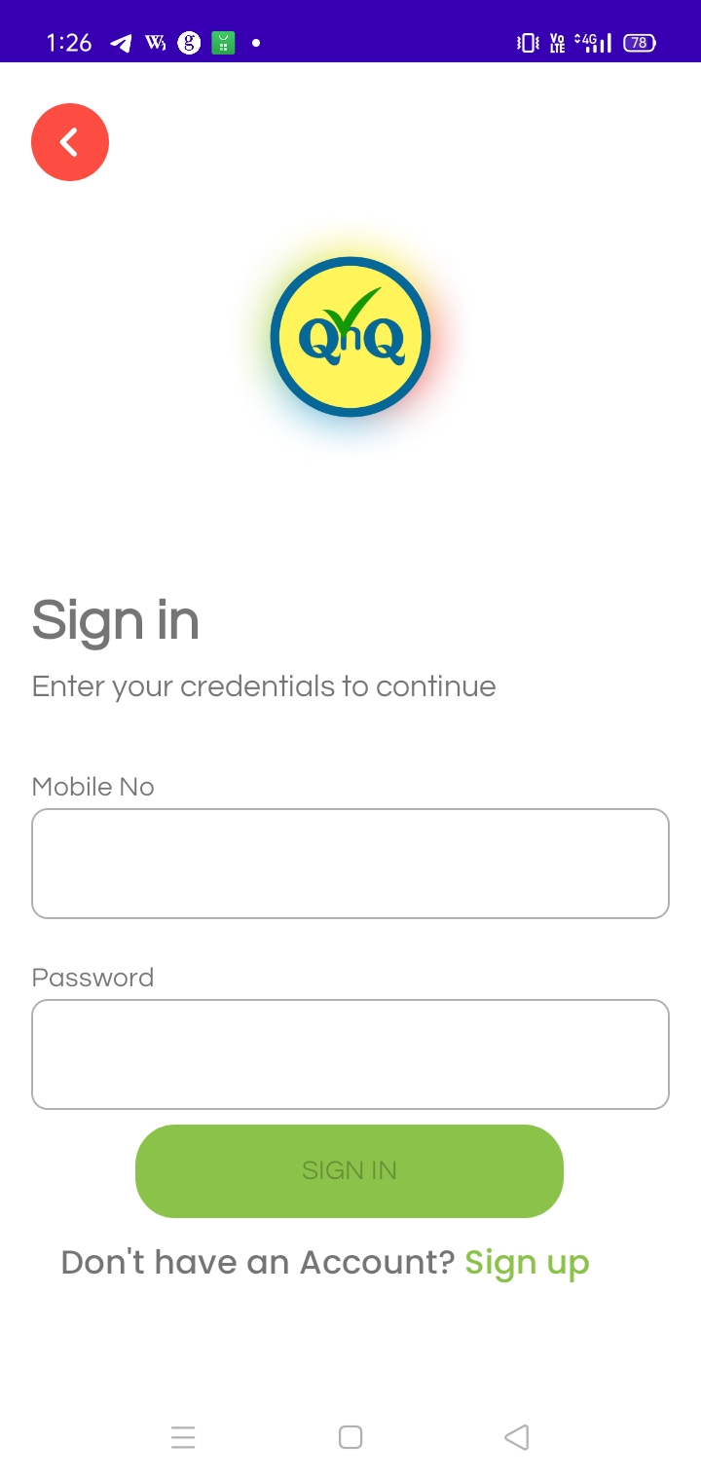
Could you please click on the video?
Please enter your login credentials.
If you already have an account, sign in to your account.
Please enter the sign-in details
MOBILE NO
PASSWORD

Slide 7




ABOUT US
Upon signing in, the welcome page will display details about
QNQ Healthcare
Our vision
Key to success on the home page.

Slide 8
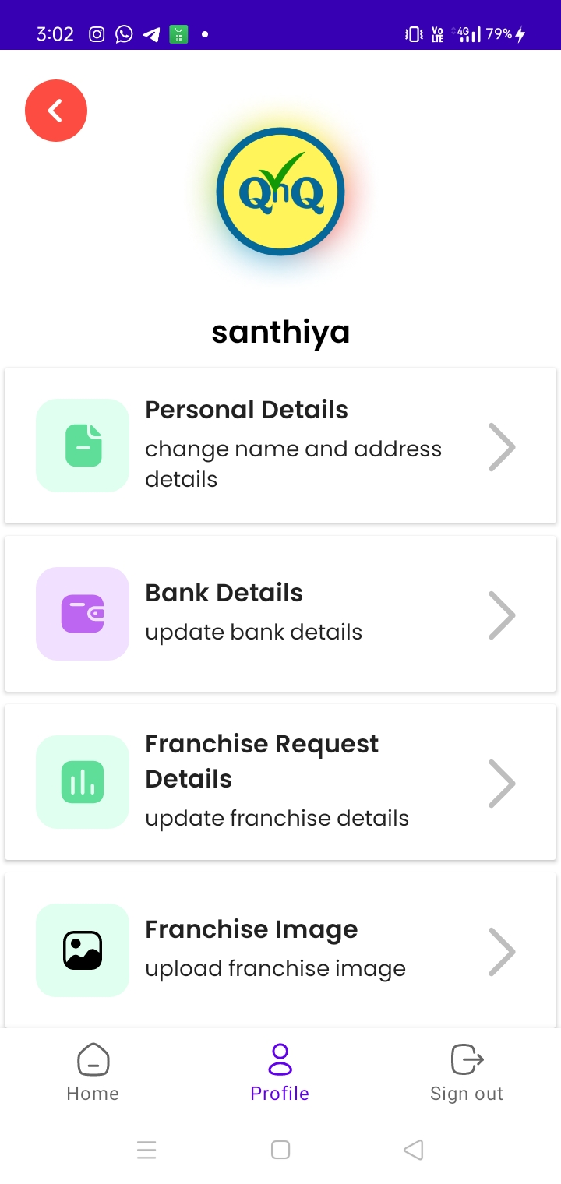

PROFILE
Click on the profile icon.
The details of the franchise inquiry form will be displayed.
This includes personal details.
It also includes bank details.
Additionally, it shows franchise request details.
Lastly, the franchise image is displayed.

Slide 9
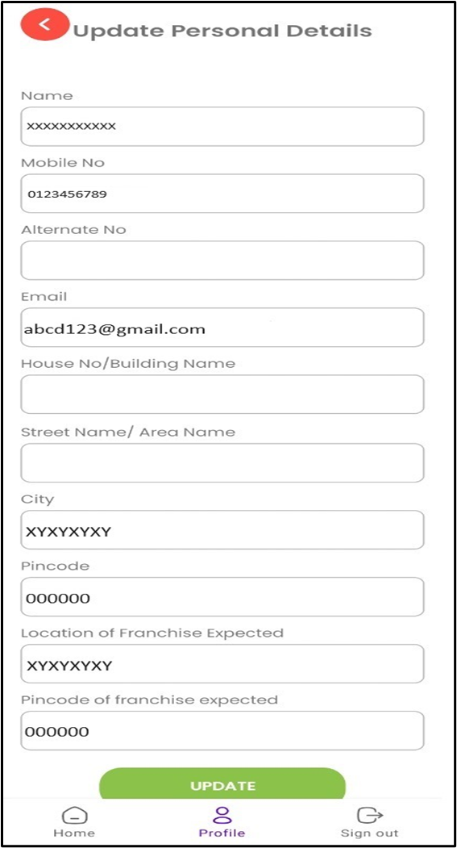
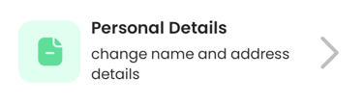
Could you please click on the video?
UPDATE YOUR DETAILS
Click the personal details drag icon to open the personal inquiry form.
Fill out the enquiry form and update the details..

Slide 10
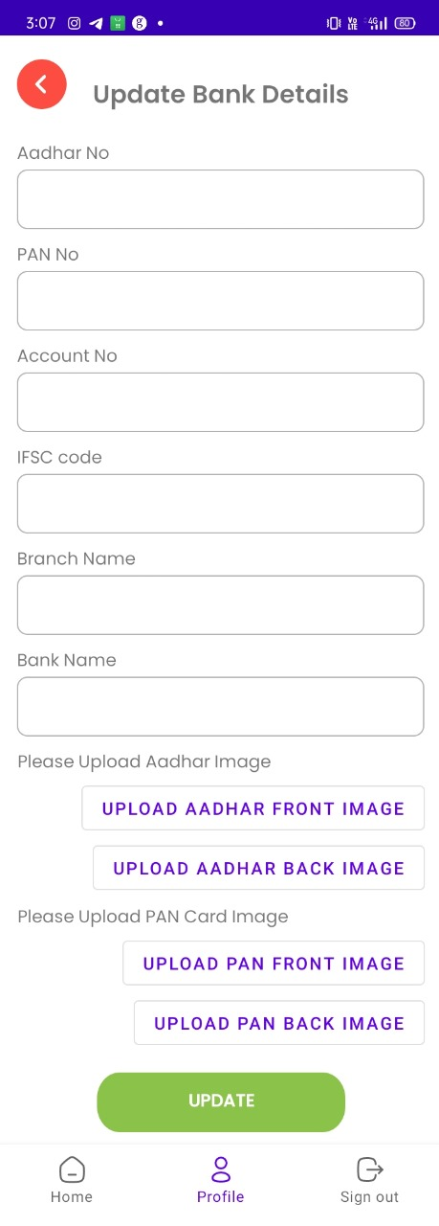


Update your bank details
Click the bank details drag icon to open the bank details form.
Aadhar No
Pan No
Account No
IFSC Code
Branch Name
Bank Name
Upload Aadhar Image
Upload Pan Card Image.
Fill out the bank details and update the form.

Slide 11
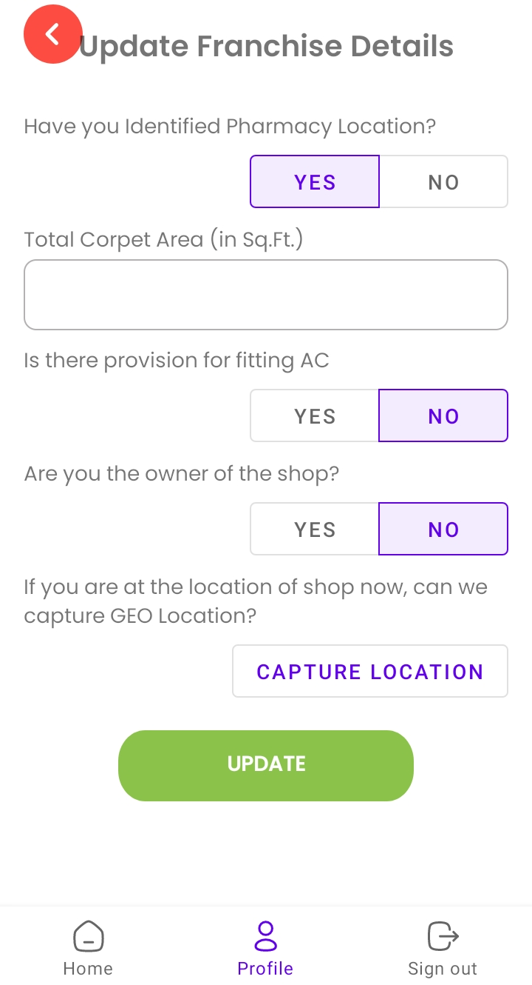

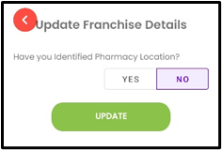
Update your Franchise Request details
Click 'Yes' to get the franchise details form
Enter the branch location details to update the franchise request.

Slide 12
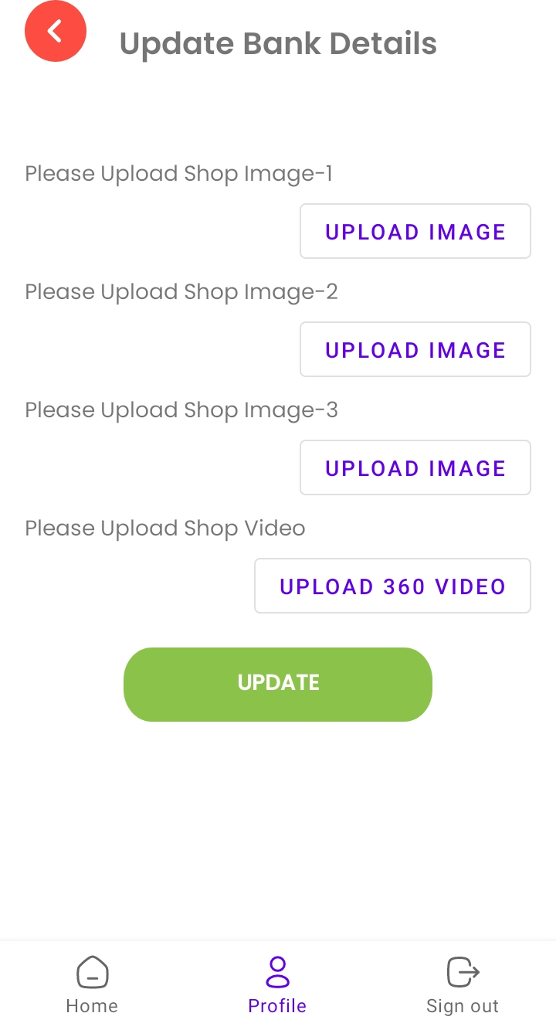

Update your Franchise Images
To update bank details, upload shop images, and a shop video, click on the "Update" button after completing the uploads.
Expect a follow-up from the proficient ‘Franchise’ teams, who will reach out to you.

Slide 13
Thank You!
,

